Slide 1
New DiD
Oct 31, 2024
(buahahaha)

Slide 2
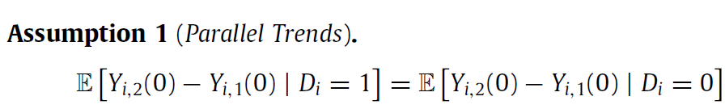

Recap of simple DiD and assumptions
If
and the error is mean independent of D, parallel assumptions hold. Note that that this means that treatment can be assigned based on things associated with the mean (time-invariant) outcome of each individual (alpha_i) but requires that treatment is not related to things that affect the trend in outcome, eta_i,t. Thus, parallel trends allows for the presence of selection bias as long as that selection bias doesn’t change over time.
Assumption 2 (No Anticipation)

Slide 3
Can extend Diff-in-diff to more than two time periods and more than two groups
time | a | b | c | d | e | f
1 | 0 | 0 | 0 | 0 | 0 | 0
2 | 0 | 0 | 0 | 0 | 0 | 0
3 | 1 | 1 | 1 | 0 | 0 | 0
4 | 1 | 1 | 1 | 0 | 0 | 0
5 | 1 | 1 | 1 | 0 | 0 | 0
treatment group
control group

Slide 4
Aside on Issues with Panel Data (even before spatial problems)
Basic issue: not all observations are the same.
An observation of GDP over two years in the same county are related differently than GDP in two different counties in the same year.
Fixed Effects
Note that FE just assumes each region has a different intercept, not different coefficients on other variables – more on that next week.

Slide 5
Random Effects
Random effects

Slide 6
Estimating RE
Just FE estimator

Slide 7
When to use which…
RE is more efficient than FE
Fixed effects make sense if each cross-sectional unit (e.g. country, industry, person) is ‘one of a kind’ and not a random draw from the same population
E.g. for countries or industries probably does not make sense to use RE
However, for large surveys where households or villages are chosen randomly and then followed over time, RE might be fine

Slide 8
Hausman test
Note that RE assume:
Whereas FE assume:
These two are the same if
Can use Hausman test.
Start with a consistent estimator, and compare it against the more efficient (but possibly inefficient) estimator

Slide 9
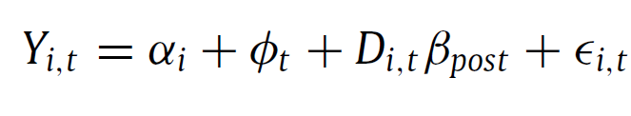
Fixed effects regressions
note that what you get is essentially changes across time
Standard multiple observation DiD uses individual (or panel-unit) fixed effects and time fixed effects:
β = Treatment effect
unit fixed
effect
time fixed
effect
D = 1 when treated (i.e. it’s equivalent to Treatment group x After)

Slide 10
roll-out design
time | Group A | Group B | Group C
1 | 0 | 0 | 0
2 | 1 | 0 | 0
3 | 1 | 1 | 0
4 | 1 | 1 | 1
comparing A to B and C is fine
comparing B to A in period 3 is potentially problematic…

Slide 11


Suppose heterogeneity in time after treatment
so every unit experiences the same treatment ‘s’ periods after treatment
Can get negative weights, which might mean beta could be negative despite all tau’s being > 0.
Imagine that treatment effect increases over time. But these units are effectively acting as ‘controls’ since treatment status ‘D’ is not changing. Can result in negative estimates of beta.
Even bigger problem if treatment effect varies over time and unit

Slide 12
For example, we may think we’re estimating the following…
outcome
treatment
control
time
-1
0
1
2
3

Slide 13
… but we may estimating …
treatment
outcome
control
time
-1
0
1
2
3

Slide 14
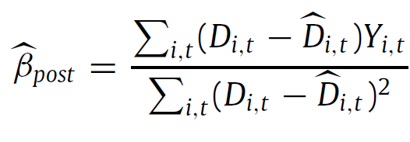





standard DiD model:
is the average of D for unit i over time
is the cross-sectional average of D for period t
If there is a unit that has been treated for almost the entire period, so and almost all units have been treated then
Thus, one can get negative weights (i.e. < 0)

Slide 15
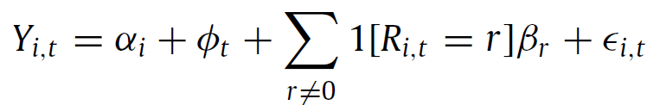
possible solution: estimate dynamic treatment
Estimate a dynamic treatment effect that varies over time, where R is the number of years since treatment
Issues with this – it can become tricky if this varies across units
can still get negative weights (as with the static treatment)
one can get non-zero weights before treatment

Slide 16
Diagnostics
look at weights
estimate ‘bounds’ on the degree of heterogeneity that could flip the sign

Slide 17
Calloway Sant’Anna
compare against never treated only
compare against never treated yet (BJS approach)

Slide 18
controlling for covariates
what if you need to control for covariates to get parallel trends:
Note that this imposes the additional assumption that the treatment effect does not vary over those covariates
Fix: Interact treatment with those covariates

Slide 19
To sum up…
Diff-in-diff works well when:
{(a) all of your treatment occurs at the same time
or
(b) your treatment effect is homogenous}
and
(c) you have parallel trends (without additional controls)
If (a) and (b) don’t hold, you can model heterogeneity (such as time after treatment). Same if you need to control for additional covariates – can model heterogeneity over covariates
Otherwise, you can use new methods to test and deal with negative weights

